Slide 1


Using Mantid to analyse crystallography data
Nick Draper
17/01/2009

Slide 2
Agenda
Introduction to the Mantid Project
Python scripting for beginners
Writing your First Algorithm
Using Mantid for diffraction data
Discussion
Notes:
Introduction to the Mantid Project
An introduction to the Mantid project including an overview of the website, where to get help and a short demonstration.
Python scripting for beginners
An introduction into the Python scripting language, moving on to write your first script to automate data processing across a group of files.
Writing your First Algorithm
When the framework does not have the algorithm you require you can simply add your own. Here we will introduce you to how to write your own algorithm.
Using Mantid for diffraction data
Laurent will explain and demonstrate the features of Mantid that support the processing of diffraction data. This will focus on power diffraction, but the demonstration will be suitable for all.
Discussion

Slide 3
Mantid
Manipulation and Analysis Toolkit for ISIS data

Slide 4
Project Aims
Aims
  To provide a framework for Data Analysis that is not instrument or technique/dependent.
  Support multiple target platforms (Windows, Linux).
  Easily extensible by Instruments Scientists/Users.
  Freely redistributable to visiting scientists.
  Provide low-level functionalities for
    Scripting
    Visualization
    Data transformation
    Implementing Algorithms
    Virtual Instrument Geometry

Slide 5
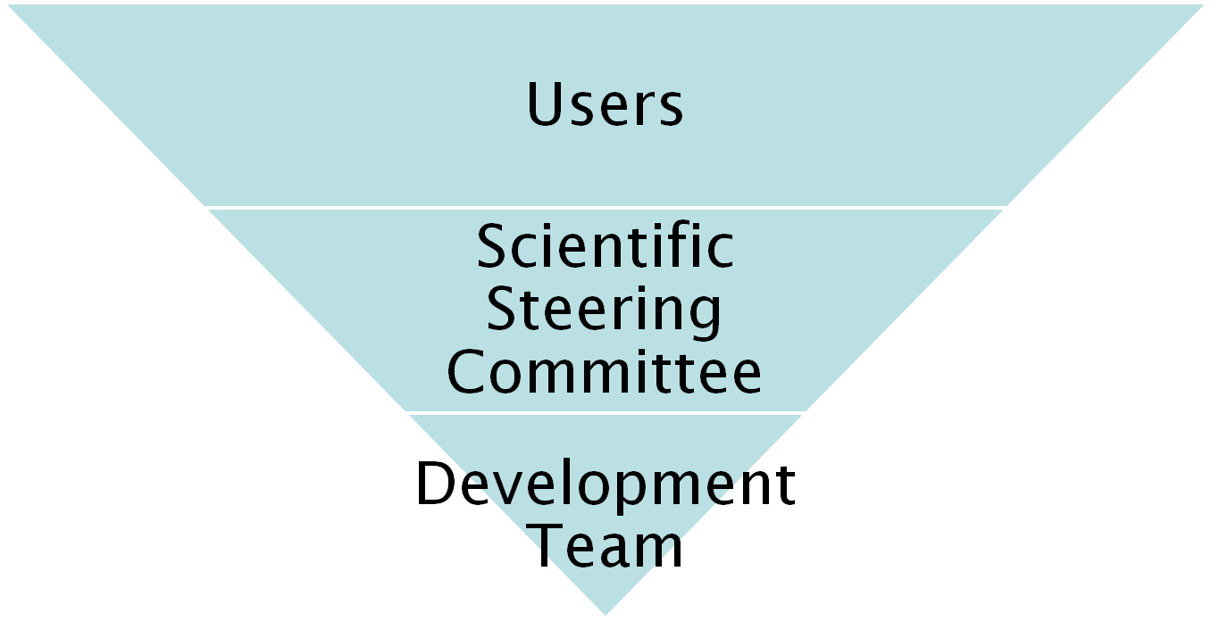
Project Organisation
27 beamlines, 1600 users
9 Key scientists representing every beamline.
PM &
7 Developers

Slide 6
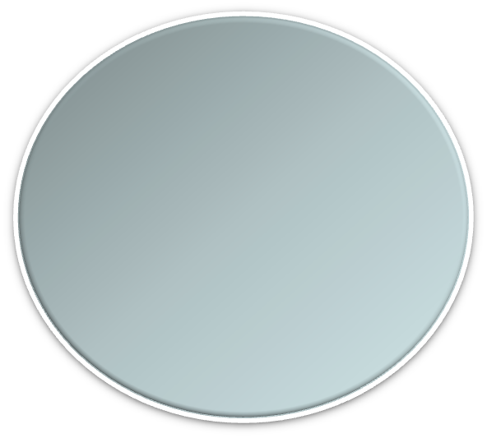


Architectural Design - Overview
Instrument log files
MantidScript
Command line & Scripting interface
RAW data files
Mantid Framework
API
Algorithms
Workspaces
MantidPlot Graphing and analysis
NEXUS data files
User Defined
User Defined
Matlab Interface
DAE direct access
Future Instrument specific UI
Future Instrument specific UI

Slide 7
Project wiki
Help
  Documentation
    User
    Developer
  Examples
Download
www.mantidproject.org

Slide 8
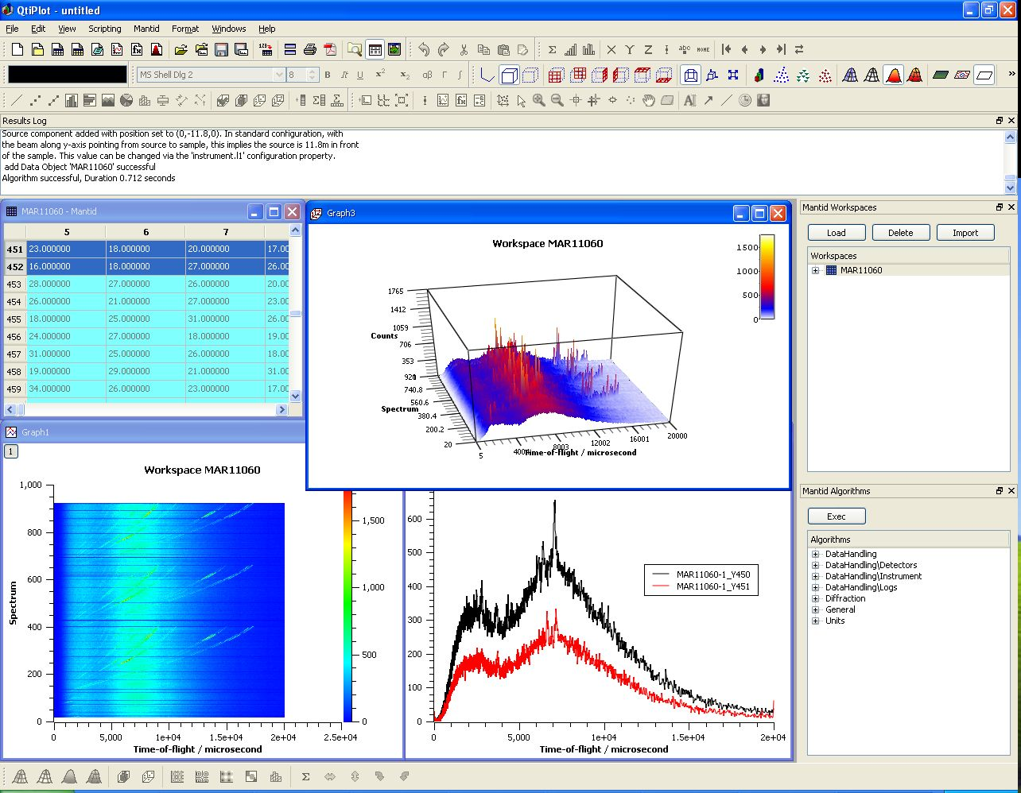
User Interfaces
Current Interfaces
  MantidPlot
    Plotting tool
    Data interaction and analysis.
    Instrument visualization
  Python
    Command line access and scripting
    Python scripting language
  Matlab Interface

Slide 9
Further Information
Project Web Page
  www.mantidproject.org
Project Introduction Document
  http://svn.mantidproject.org/mantid/trunk/Documents/Requirements/Project%20Introduction%20Document.doc
User Requirements Document
  http://svn.mantidproject.org/mantid/trunk/Documents/Requirements/URD.doc
Architectural Design Document
  http://svn.mantidproject.org/mantid/trunk/Documents/Design/Architecture%20Design%20Document.doc

